Slide 1

SAFE SHORELINE ENTERTAINMENT CORPORATION
By:
Bharat Singh (Project Lead)
Gert Xani (Tech Lead)
Paakwesi Yankson (Business Consultant)
27 Oct 2026

Slide 2

MISSION
“To provide SAFE beach experience, attract more visitors and boost local ECONOMY”

Slide 3

Overview
Propose safe location and time for your seashore leisure.
Data Set :- Shark Attack Quest
  The data set contains the logged data for shark attacks around the world at different locations by the people in their reports including the severity of the attacks by time and activity.
Data Analysis:- a. Trend analysis over past 20 years.
b. Top activities during which attacks were reported.
c. Time of day.
d. Attacks count and fatality rate by countries.

Slide 4
DATA WRANGLING AND CLEANING
Step 1
Step 2
Step 3
Removal of all blank column and rows to bring down the scale of data.
Dropping the unwanted data which are not necessary for the analysis.
Dealing with null values, clearing out expressions, check on duplicates, dtype transformation, standardisation.
Aggregate analysis.
Analysis through tables for the insights.

Slide 5
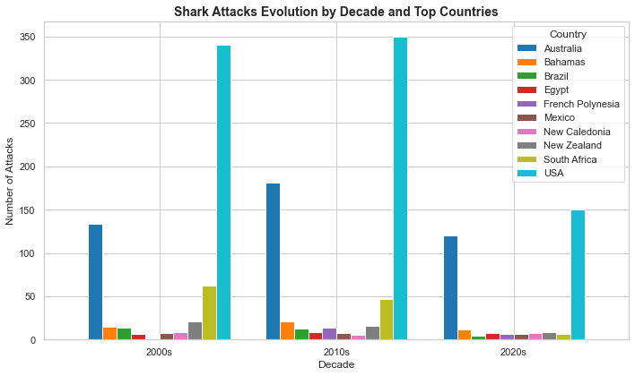

Slide 6
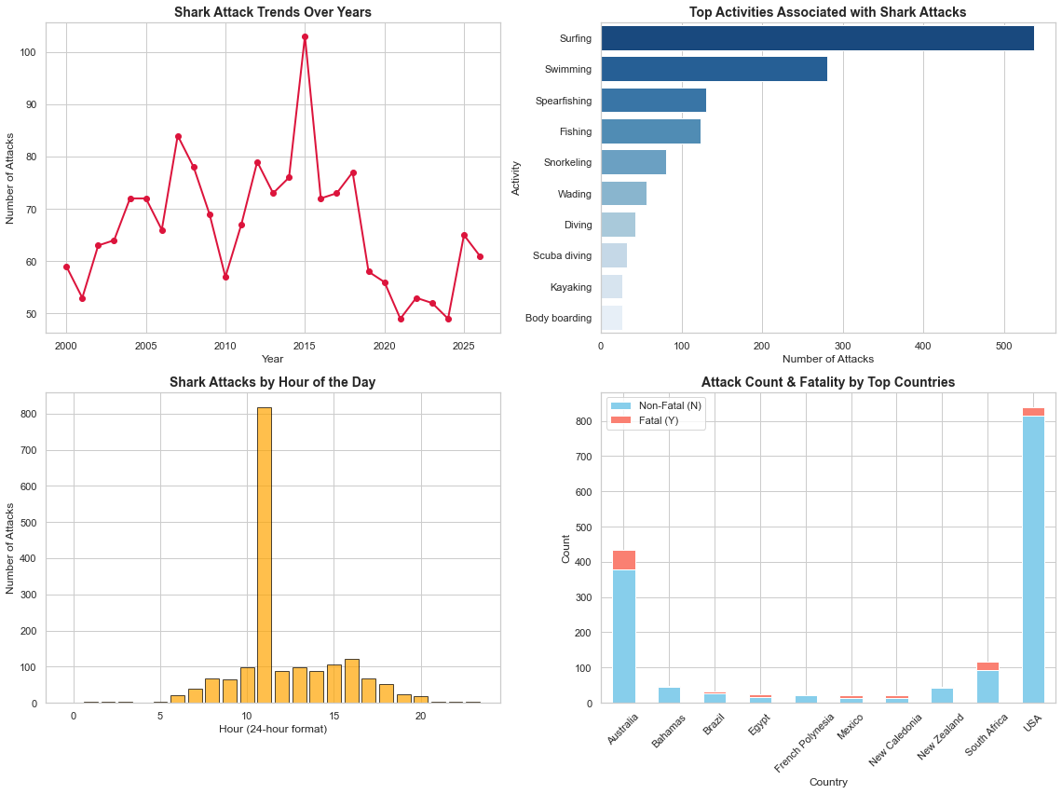
Exploratory Data Analysis

Slide 7
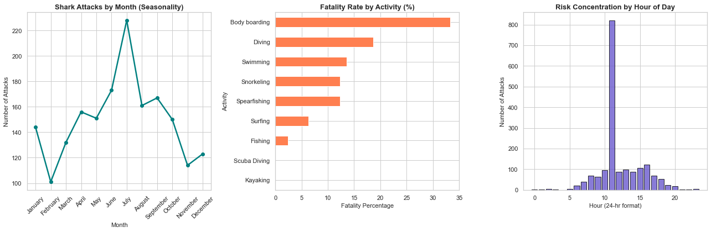

Slide 8

Major Obstacle
Scope/ Business idea - Frame
Data Cleaning (especially special characters)
3. Relationship establishment.

Slide 9

Sr. | Country Name | Best Time of Day
1 | Canada | For Safe Countries: All around the year any time For Risky zones/ countries:- B/w 7-9am & after 4pm Safest Months:- February & November Safest Activities (with zero provokenness):- Kayaking Bodyboarding Scuba Diving
2 | Canary Islands
3 | Cayman Islands
4 | Colombia
5 | Cuba
6 | Ecuador
7 | Fiji
8 | Galapogos Islands
9 | India
10 | Indonesia
Proposal

Slide 10
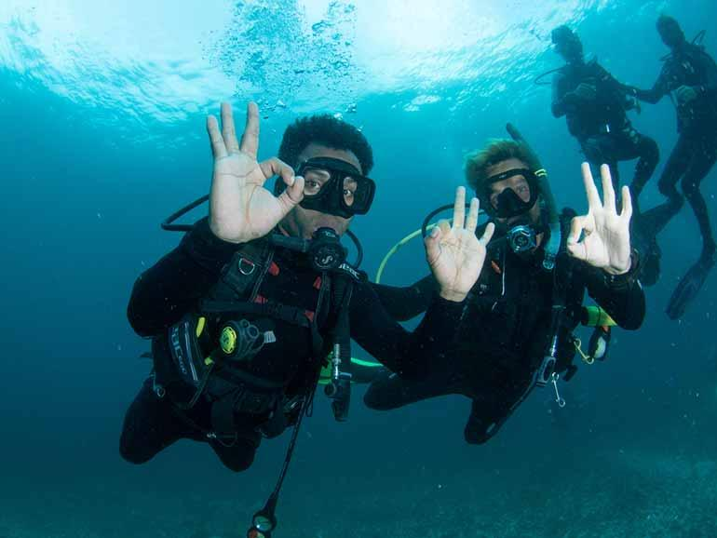
THANK
YOU

